Slide 1
Lab 2: Intel 80x86 Architecture
COP 3402
September 5th, 2018

Slide 2
Intel 80x86 CPU Instruction Set
Memory
8-bit bytes
Each memory byte has 32-bit label called a physical address
Addresses are byte addresses
Memory size = 4,294,967,296 (2^32) bytes
bits within bytes numbered right (lsb) to left (msb) 0 to 7
+-+-+-+-+-+-+-+-+
7 6 5 4 3 2 1 0 <- bit number
bytes within word numbered right (LSB) to left (MSB) 0 to 1 - "little endian"
+--------+--------+
1 0 <- byte number
Notes:
http://www4.wittenberg.edu/academics/mathcomp/shelburne/comp255/notes/Intel80x86Overview.html

Slide 3
x86 Instruction Set
Registers:
16 General purpose registers
Most concern to a programmer
Registers are 16 to 32 bits long
Internal storage that is faster and easier to access than RAM

Slide 4
80x86 Register History
With the advent of the 32-bit 80386 processor, the 16-bit general-purpose registers, base registers, index registers, instruction pointer, and FLAGS register, but not the segment registers, were expanded to 32 bits. This is represented by prefixing an "E" (for Extended) to the register names in x86 assembly language. Thus, the AX register corresponds to the lowest 16 bits of the new 32-bit EAX register, SI corresponds to the lowest 16 bits of ESI, and so on. The general-purpose registers, base registers, and index registers can all be used as the base in addressing modes, and all of those registers except for the stack pointer can be used as the index in addressing modes.
Notes:
http://en.wikipedia.org/wiki/X86

Slide 5
Registers Format
General Purpose Registers
31-24 | 23-16 | 15-8 | 7-0
EAX, EBX, ECX, EDX
 |  | AX, BX, CX, DX
 |  | *H | *L
Data Registers/General Purpose
A, B, C, D (EAX, EBX, ECX, EDX)
EAX called accumulator (arithmetic results often go here)

Slide 6
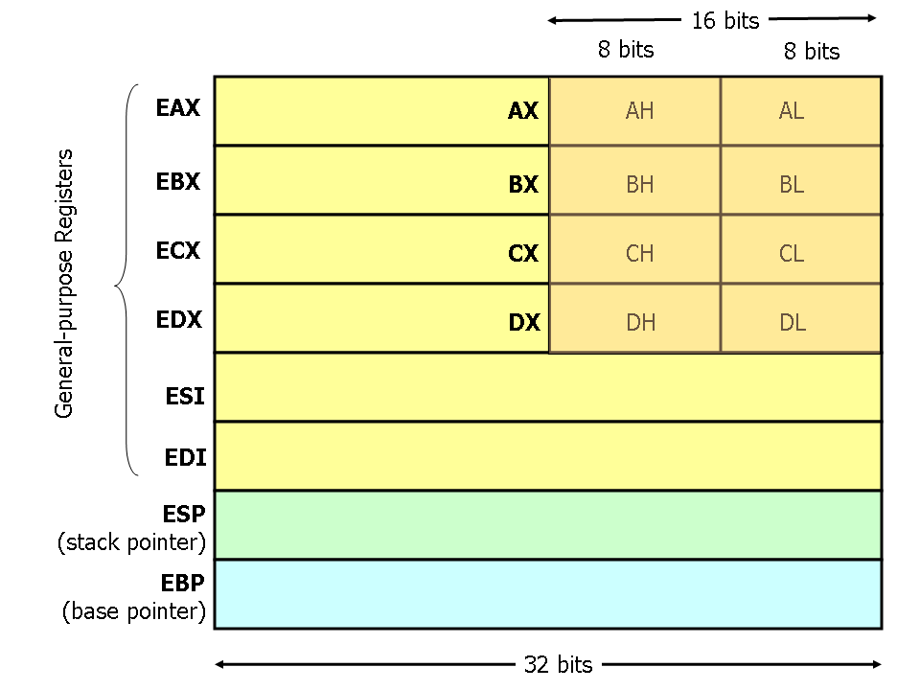
x86 General Register Sizes
Notes:
Image courtesy of http://www.cs.virginia.edu/~evans/cs216/guides/x86.html
*

Slide 7
General Register List
Mnemonic | Length | Special Use
EAX | 32 | Accumulator; General purpose
EBX, ECX, EDX | 32 | General purpose
ESI | 32 | Source index; source address
EDI | 32 | Destination index; address of destination
ESP | 32 | Stack pointer; address of top of stack
EBP | 32 | Base pointer; address of reference point in stack
CS, DS, ES, SS, FS, GS | 16 | Selector for “Code Segment”, “Data Segment”, “Extra Segment”, “Stack Segment”, and “Additional Segments”
EIP | 32 | Instruction pointer; next instruction
EFLAGS | 32 | Collection of flags and status bits (carry, parity, zero, sign, overflow, etc.)

Slide 8
x86 Integers and Strings
Data Formats:
Integers stored as binary numbers, 8 bits (byte), 16 bits (word), 32 bits (double-word), 64 bits (quadword)
697₁₀ = 0000 0010 1011 1001₂ (word)
= 00 00 02 B9₁₆ (dword)
2’s complement representation is used for negative values
-565₁₀ = 1111 1101 1100 1011₂ (word)
= FF FF FD CB₁₆ (dword)
Characters often stored using 8-bit ASCII codes

Slide 9
Floating Points in x86
FPU (floating point unit)
Separate part of chip that does floating point math
Has its own registers, separate from integer operations
Architecture of FPU is outside scope of this class
Floating Point Format
Sign bit: 1 bit
Exponent width: 8-11 bits
Significand precision/fraction: 24-53 (23-52 explicitly stored)
Two standards: IEEE single, IEEE double
Notes:
Images in the public domain, courtesy of wikipedia
*

Slide 10

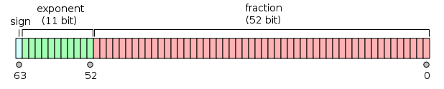
Floating Point Singles and Doubles
Single Value = (−1)^{sign} × (1._{fraction part}) × 2^{e-127}
Max value ≈ 3.40×10³⁸, Min value ≈ 1.18×10⁻³⁸
Double Value = (−1)^{sign} × (1._{fraction part}) × 2^{e-1023}
Max value ≈ 1.79×10³⁰⁸, Min value ≈ 2.23×10⁻³⁰⁸

Slide 11
x86 Assembly Language
Instructions:
Assembly language instructions directly converted to object code (byte code)
Typically take the form of
Mnemonic Operand1(trgt), Operand2(src), [Op3], [Op4]
Typically 1 byte (but can be 2) for mnemonic opcode
Example:
add eax, 158 (Adds 158 to whatever is in the EAX register)

Slide 12
x86 Instruction Set & Addressing
Instruction Set:
Large set of instructions, commonly used mnemonics (mov, add, sub, mul, div, jmp)
Addressing Modes
Immediate – data in the instruction itself
Register – data in a register
Memory – data at some memory address
Memory Modes
Direct – memory location built into the instruction
Register indirect – memory location’s address in a register

Slide 13
Sample Program
mov eax, 36 | ; move 36 into eax register
imul eax, 9 | ; “immediate” multiple previous line by 9. eax = eax×9
mov ebx, 5 | ; divisor
cdq | ; convert ebx double to quadword (prepare for division)
idiv ebx | ; divide (implicit accumulator) by ebx. eax = eax÷5
add eax, 32 | ; eax = eax+32
mov [02CDh], eax | ; save results to memory address 02CD₁₆
Converts temperature (36°) from Celsius to Fahrenheit
(36×9)÷5+32 = 96

Slide 14
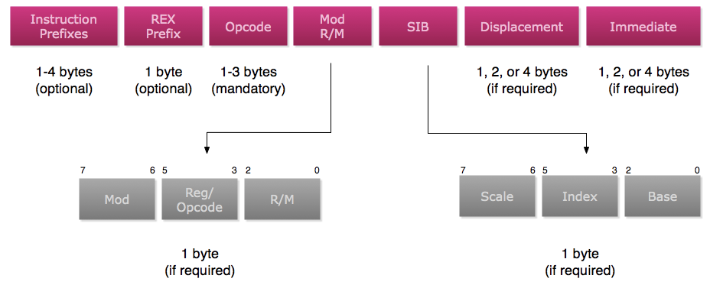
x86 Instruction Formatting
Instruction Formats:
Notes:
*
1-5 byte addresses
*

Slide 15
MOD / R/M
The Mod r/m byte determines the addressing mode, whether the instruction is memory to register, register to register, or register to memory and which registers are used.

Slide 16
MOD / REG Tables
Mod | Displacement
00 | If r/m is 110, Displacement (32 bits) is address; otherwise, no displacement
01 | Eight-bit displacement, sign-extended to 32 bits
10 | 32-bit displacement (example: MOV [BX + SI]+ displacement, AL)
11 | r/m is treated as a second "reg" field
Reg | W=0 | W=1 | Double word
000 | AL | AX | EAX
001 | CL | CX | ECX
010 | DL | DX | EDX
011 | BL | BX | EBX
100 | AH | SP | ESP
101 | CH | BP | EBP
110 | DH | SI | ESI
111 | BH | DI | EDI
Notes:
http://en.wikibooks.org/wiki/X86_Assembly/Machine_Language_Conversion#8086_instruction_format_.2816_bit.29
*

Slide 17
R/M Tables
R/M stands for Register/Memory operand.
Tells how the rest of the instruction is structured (3 bits)
R/M | Operand Address
000 | (BX) + (SI) + displacement (0, 1, 2, or 4 bytes long)
001 | (BX) + (DI) + displacement (0, 1, 2, or 4bytes long)
010 | (BP) + (SI) + displacement (0, 1, 2, or 4bytes long)
011 | (BP) + (DI) + displacement (0, 1, 2, or 4bytes long)
100 | (SI) + displacement (0, 1, 2, or 4bytes long)
101 | (DI) + displacement (0, 1, 2, or 4bytes long)
110 | (BP) + displacement unless mod = 00 (see mod table)
111 | (BX) + displacement (0, 1, 2, or 4 bytes long)
Note special meaning of MOD 00, r/m 110. Normally, this would be expected to be the operand [BP]. However, instead the 32-bit displacement is treated as the absolute address. To encode the value [BP], you would use mod = 01, r/m = 110, 8-bit displacement = 0.
Notes:
http://en.wikibooks.org/wiki/X86_Assembly/Machine_Language_Conversion#8086_instruction_format_.2816_bit.29
r/m Operand address
000 (BX) + (SI) + displacement (0, 1 or 2 bytes long)
001 (BX) + (DI) + displacement (0, 1 or 2 bytes long)
010 (BP) + (SI) + displacement (0, 1 or 2 bytes long)
011 (BP) + (DI) + displacement (0, 1 or 2 bytes long)
100 (SI) + displacement (0, 1 or 2 bytes long)
101 (DI) + displacement (0, 1 or 2 bytes long)
110 (BP) + displacement unless mod = 00 (see mod table)
111 (BX) + displacement (0, 1 or 2 bytes long)
*

Slide 18
x86 Instruction Format
Example:
xor CL, [12H]
Exclusive Or the contents of register CL (last byte of ECX register) with contents of address 12H
Opcode for xor is 001100dw
d = direction = 1 because CL is the destination
w = dword vs. byte = 0 because we are using bytes
Code for CL is 001
MOD = 00 (Because we have simple displacement)
R/M = 110
So… xor CL, [12H] =
00110010 00001110 00010010 00000000 00000000 00000000₂
32 0E 12 00 00 00₁₆
Notes:
*
http://en.wikibooks.org/wiki/X86_Assembly/Machine_Language_Conversion#8086_instruction_format_.2816_bit.29

Slide 19
x86 Instruction Format
Example:
add AL, 12H
Add 12H to AL.
Opcode for add (immediate) is 00000100
Code for AL is 000
MOD = 11 (Because we need to use r/m as a register field)
reg = 110 (Because are using an immediate operation)
So… add AL, 12H =
00000100 11110000 00010010₂
04 F0 12₁₆
mod r/m
opcode
mod
reg
r/m
immediate
00000100
11
110
000
00010010
Notes:
*
http://en.wikibooks.org/wiki/X86_Assembly/Machine_Language_Conversion#8086_instruction_format_.2816_bit.29

Slide 20
x86 Instruction Format
Example:
add AL, BL
Add the content of BL to AL.
Opcode for add is 00000010
Code for AL is 000
Code for BL is 011
MOD = 11 (Because we need to use r/m as a register field)
So… add AL, BL =
00000010 11000011₂
02 C3₁₆
mod r/m
opcode
mod
reg
r/m
00000010
11
000
011
Notes:
*
http://en.wikibooks.org/wiki/X86_Assembly/Machine_Language_Conversion#8086_instruction_format_.2816_bit.29

